Slide 1
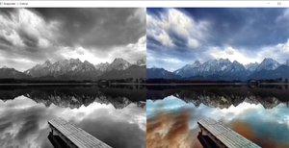
AATHIKARTHI PS
Image Colorization using Generative Adversial Network(GAN)
3/21/2024 Annual Review

Slide 2
IMAGE COLORIZATION USING GAN
Image Colorization Using GAN is a groundbreaking solution harnessing Generative Adversarial Network technology to automatically add vibrant colors to grayscale images. With applications spanning artistic enhancement, historical preservation, and visual storytelling, this project unlocks new creative possibilities.
By seamlessly transforming black and white images into color-rich visuals, it empowers photographers, designers, historians, and content creators to enhance their work and engage audiences on a deeper level. This innovative approach to colorization combines the power of deep learning with artistic expression, bridging the past and present in a visually captivating manner.
3/21/2024 Annual Review

Slide 3
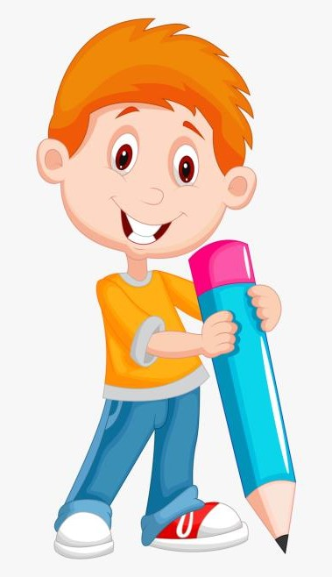

AGENDA
PROJECT TITLE
AGENDA
PROBLEM STATEMENT
PROJECT OVERVIEW
WHO ARE THE END USER
YOUR SOLUTION AND VALUE PROPOSITION
THE WOW IN YOUR SOLUTION
MODELLING
RESULTS
3/21/2024 Annual Review

Slide 4

PROBLEM STATEMENT
In various industries and creative endeavors, grayscale images often lack the vibrant visual impact that colorization can provide. However, manually colorizing images can be time-consuming and labor-intensive, hindering productivity and creativity. Our project addresses this challenge by leveraging Generative Adversarial Network (GAN) technology to automate the colorization process, transforming grayscale images into colorful representations with remarkable accuracy and efficiency.
By automating colorization, our solution empowers artists, photographers, historians, and content creators to enhance their work with vibrant colors, preserving historical moments, creating captivating visuals, and exploring new creative avenues. This streamlined approach to colorization not only saves time and effort but also elevates the overall quality and impact of visual content across various domains.
3/21/2024 Annual Review

Slide 5
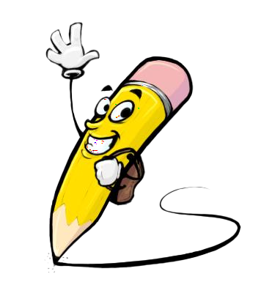
PROJECT OVERVIEW
Our project focuses on Image Colorization using Generative Adversarial Networks (GANs) to automatically add vibrant colors to grayscale images. The goal is to develop an innovative solution that enhances the visual appeal of images without the manual effort traditionally required for colorization. By leveraging GAN technology, we aim to streamline the colorization process and enable users to transform black and white visuals into vivid, realistic color representations seamlessly.
The project's significance lies in its ability to revolutionize how grayscale images are transformed into colorful artworks, historical artifacts, and engaging visual content across various industries and creative endeavors. This automated approach to colorization not only saves time and resources but also opens up new possibilities for artistic expression, storytelling, and digital content creation.
3/21/2024 Annual Review

Slide 6

WHO ARE THE END USERS?
Businesses, schools, public transportation authorities, healthcare facilities, and government agencies are stakeholders who can benefit from our Image Colorization Using GAN solution. These entities may utilize the system to:
Enhance visual content: Businesses can use colorization to create eye-catching marketing materials, product images, and branding assets.
Preserve historical images: Schools and museums can colorize old photos and documents to bring history to life and engage students and visitors.
Improve patient care: Healthcare facilities can use colorized medical images for diagnostics, patient education, and research purposes.
Enhance urban planning: Government agencies can utilize colorized aerial images and maps for urban planning, infrastructure development, and environmental studies.
Create immersive experiences: Entertainment industry can leverage colorization to enhance visual effects, restore old films, and create immersive digital experiences.
3/21/2024 Annual Review

Slide 7
YOUR SOLUTION AND ITS VALUE PROPOSITION
Automated Detection: Our Image Colorization Using GAN solution leverages advanced Generative Adversarial Network (GAN) technology to automatically add vibrant colors to grayscale images, eliminating the need for manual colorization efforts.
Efficiency & Accuracy: By automating the colorization process, our system saves time and resources while ensuring accurate and realistic color representations, enhancing the overall quality of visual content.
Enhanced Visual Appeal: By seamlessly transforming grayscale images into colorful artworks, our solution enhances the visual appeal of visuals, creating captivating and engaging content across industries and creative endeavors.
3/21/2024 Annual Review

Slide 8
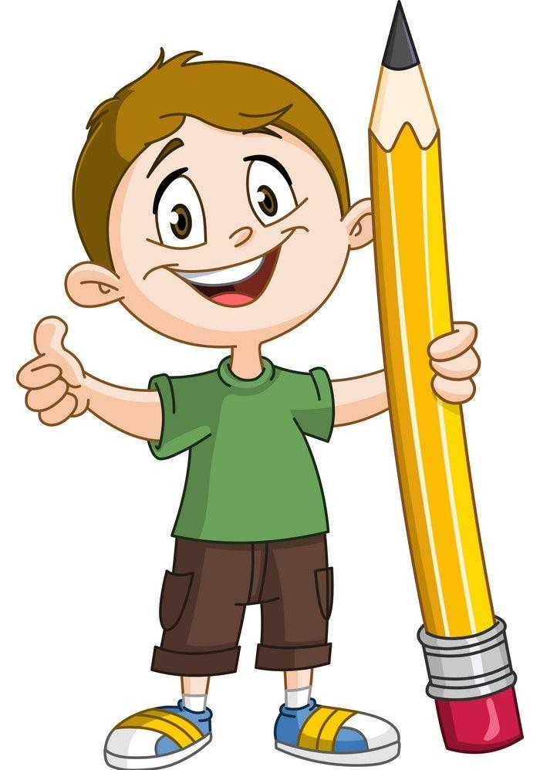
THE WOW IN YOUR SOLUTION
Real-Time Detection: Our Image Colorization Using GAN solution provides instant colorization of grayscale images, offering immediate visual feedback to users.
High Accuracy: Leveraging advanced Generative Adversarial Network (GAN) technology, our system ensures precise colorization results, minimizing errors and discrepancies in the colorized images.
User-Friendly Interface: Designed with usability in mind, our system offers an intuitive and easy-to-navigate interface, making it accessible to users of all skill levels. It includes features such as drag-and-drop functionality, real-time preview, and adjustable colorization settings.
3/21/2024 Annual Review
8

Slide 9
MODELLING
Modeling Process:
Data Collection
Preprocessing
Model Selection
Training
Evaluation
Optimization
Deployment
3/21/2024 Annual Review
9

Slide 10
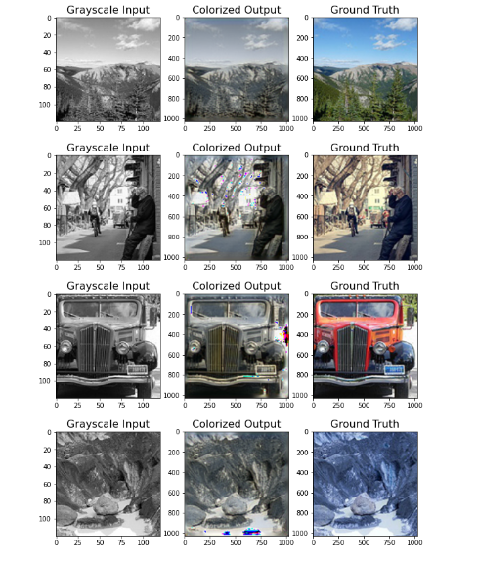
RESULTS
Output Images
3/21/2024 Annual Review
10

